Slide 1
Introduction to AI
Exploring RAG, Hugging Face, LangChain, and AI

Slide 2
AI refers to machines designed to perform tasks that typically require human intelligence, such as understanding language, recognizing patterns, and making decisions. Fun Fact: The term "Artificial Intelligence" was coined in 1956 by John McCarthy at the Dartmouth Conference. Lesser-Known Fact: The first AI program, called the Logic Theorist, was created in 1955 and could prove mathematical theorems.

Slide 3
01
Evolution of Language Models

Slide 4
Early Days (1960s-1990s):
Rule-based systems like ELIZA (1966) and SHRDLU (1970).
Fun Fact: ELIZA could simulate a psychotherapist by using simple pattern matching, but it had no understanding of language.
Statistical Era (1990s-2010s):
Models like n-grams and Hidden Markov Models (HMMs).
Focused on probability and pattern recognition.
Lesser-Known Fact: Google’s early search algorithms relied heavily on n-grams.

Slide 5
Deep Learning Revolution (2010s-Present):
Introduction of neural networks and Transformers (2017).
Fun Fact: The Transformer architecture was introduced in the paper "Attention is All You Need" and revolutionized NLP by enabling models to process entire sentences at once.

Slide 6
Neural Networks

Slide 7
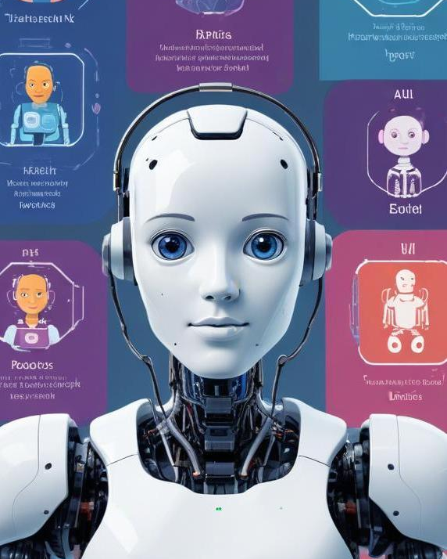
The Rise of LLMs
What are LLMs?
LLMs are large-scale neural networks trained on vast amounts of text data.
Examples: GPT-3, GPT-4, BERT, T5.
Fun Fact: GPT-3 has 175 billion parameters, making it one of the largest models ever created!
Why Size Matters:
Larger models can capture more nuanced language patterns.
Lesser-Known Fact: Training GPT-3 cost an estimated $4.6 million in computational resources.

Slide 8
The Emergence of ChatGPT
What is ChatGPT?
ChatGPT is a conversational AI model developed by OpenAI, based on the GPT architecture.
Fun Fact: ChatGPT was released in November 2022 and reached 1 million users in just 5 days!
How ChatGPT Works:
Fine-tuned using Reinforcement Learning from Human Feedback (RLHF).
Lesser-Known Fact: ChatGPT was trained on a mix of licensed data, publicly available data, and data written by human trainers.
Fun Fact: ChatGPT can simulate historical figures like Shakespeare or Einstein!

Slide 9
Small Language Models (SLMs)
What are SLMs?
SLMs are smaller, more efficient models designed for specific tasks.
Examples: DistilBERT, TinyBERT.
Fun Fact: SLMs are often used in mobile apps and IoT devices due to their lower computational requirements.
Advantages of SLMs:
Faster inference, lower cost, and easier deployment.
Lesser-Known Fact: SLMs can sometimes outperform LLMs in specialized tasks with less data.

Slide 10
02
Comparison of LLMs and SLMs

Slide 11
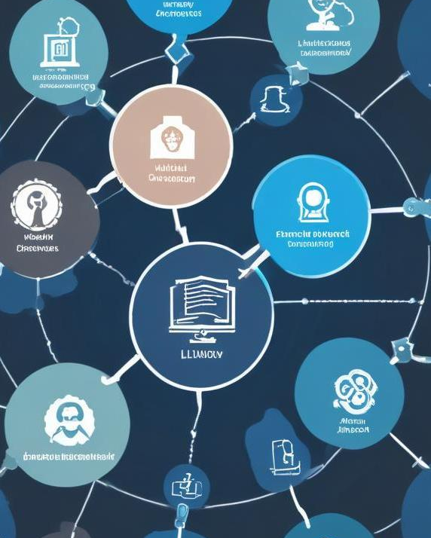
Feature | LLMs | SLMs
Size | Billions of parameters | Millions of parameters
Use Case | General-purpose tasks | Specific, narrow tasks
Cost | High | Low
Speed | Slower | Faster
Examples | GPT-3, GPT-4, BERT | DistilBERT, TinyBERT
Fun Fact: GPT-4 can process 25,000 words in a single prompt, while SLMs like DistilBERT are optimized for real-time applications.

Slide 12
RAG (Retrieval-Augmented Generation)
What is RAG?
RAG combines retrieval-based methods with generative models to improve accuracy and relevance.
How it Works: The model retrieves relevant documents and then generates responses based on that information.
Fun Fact: RAG was introduced by Facebook AI in 2020 and is used in systems like ChatGPT to provide more accurate answers.

Slide 13
Hugging Face
What is Hugging Face?
Hugging Face is a company that provides open-source tools and models for NLP.
Fun Fact: The name "Hugging Face" comes from the emoji 🤗, symbolizing the friendly and approachable nature of the platform.
Key Contributions:
Transformers library: Simplifies the use of models like BERT and GPT.
Model Hub: A repository of pre-trained models.
Lesser-Known Fact: Hugging Face has over 100,000 models available for free!

Slide 14
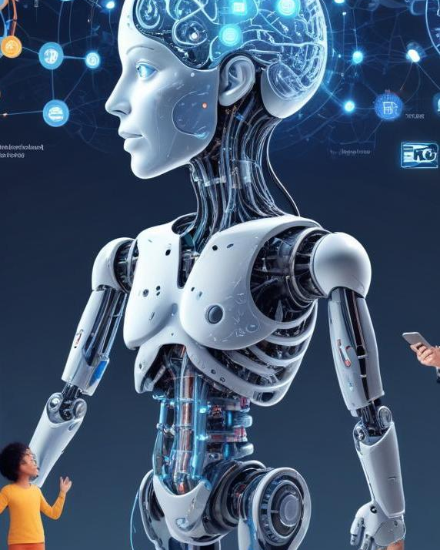
LangChain
What is LangChain?
LangChain is a framework for building applications powered by language models.
Key Features: Memory, context awareness, and integration with external data sources.
Fun Fact: LangChain was created by Harrison Chase in 2022 and has quickly become a favorite among developers.
Use Cases:
Chatbots, question-answering systems, and automated content generation.
Lesser-Known Fact: LangChain can integrate with tools like Google Search and Wikipedia to provide real-time information

Slide 15
AI Ethics and Challenges
Bias in AI models.
Environmental impact of training large models.
Fun Fact: Training a single LLM can emit as much carbon as 5 cars over their lifetimes!

Slide 16
Thank you!
Do you have any questions?

